Slide 1
Inventory & Order Tracker
Salesforce LWC + Apex + Automation Project
T N Kushal

Slide 2
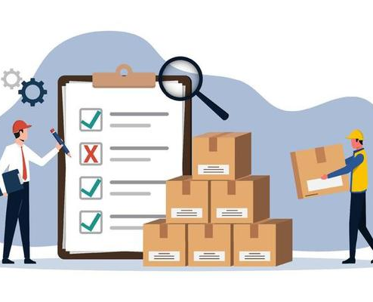
Problem Statement
Businesses struggle with manual inventory and order management.
Challenges:
Stock mismanagement
Delayed order processing
Lack of visibility across products
Goal: Automate and visualize inventory & order data in real-time.

Slide 3

Small and medium businesses often manage products and orders manually, leading to errors and delays.This project builds a Salesforce app to manage products, orders, and order items efficiently.Automatic stock adjustments occur when orders are placed, ensuring real-time inventory updates.A Lightning Dashboard with LWCs provides a clear view of products, stock alerts, and orders.The solution demonstrates Salesforce customization for quick reporting and streamlined order management

Slide 4

Project Goals
Build a real-time inventory dashboard.
Automate order processing and stock updates using Apex/Flows.
Enable data-driven decisions via reports & charts.
Integrate external APIs for additional inventory info.

Slide 5
Architecture & Components
Objects: Product_c, Orderc, Order_Item_c.
LWCs: ProductList, OrderList, InventoryDashboard, StockSummary
Apex Classes: InventoryController, InventoryCallout, OrderItemHandler, InventoryRestService
Automation: Triggers, Flows, Platform Events, CDC
Visual: Diagram connecting objects, LWCs, triggers

Slide 6
Key Features
Inventory Dashboard with live product stock.
Order creation & automatic stock update.
Reports: Tabular, Summary, Matrix, Chart visualization.
LWC integrations with Apex & external APIs.
Security: Sharing rules, OWD, field-level security.

Slide 7
THANK YOU

